Slide 1
Development of an Ecommerce website for a Shoe brand
Dhruv Bramhankar 18BEE1109
Shivansh 19BLC1037
Pratyush Motha 19BLC1046

Slide 2
PROBLEM STATEMENT
Developing a Database Management System in the form of an E-commerce website for a Shoe brand named PratShoes, taking into account entities like –
User (consumer)
Product (Shoes)
Order
Claim

Slide 3
Overview of Platform
There will be a role based login, Admin and User.
1. Site admin will be able to add/ edit/ delete products to the website, manage orders, manage customers.
2. Users can view the products and place orders.
3. Users can raise claim for the placed orders.
4. Payment Options:
- Razorpay for Online Paymeny
- Cash on Delivery

Slide 4
REQUIREMENTS
Node.js to power backend
Express as web framework
MongoDB as database
Mongoose as MongoDB driver
MongoDB atlas for cloud data storage
ReactJs as frontend side library
MaterialUI as CSS framework

Slide 5
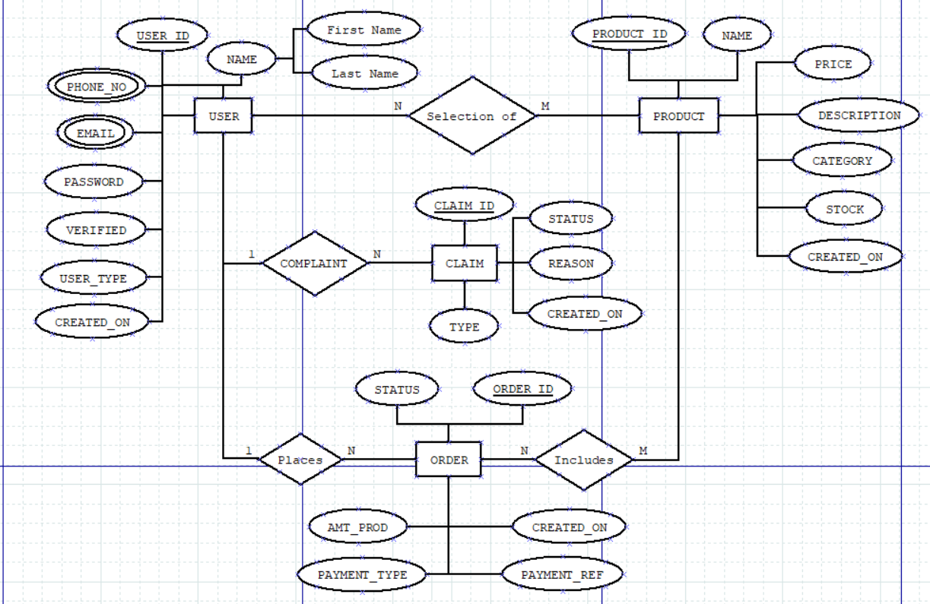
ER DIAGRAM

Slide 6
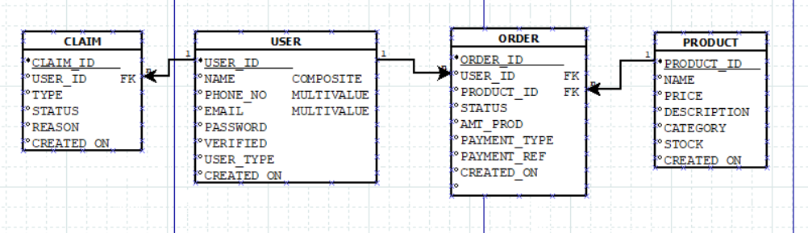
Relational Model

Slide 7
THANK YOU

